Slide 1

Control bus

Slide 2
EE-2003
Computer Organization & Assembly Language
INSTRUCTOR
Engr. Aamir Ali
Lecturer, Department of Electrical Engineering
Office: 1st Floor EE Faculty
FAST NUCES (Karachi)
aamir.ali@nu.edu.pk

Slide 3
Shift & Rotate

Slide 4
Shift and Rotate Instructions
Logical vs Arithmetic Shifts
SHL and SHR Instruction
SAL and SAR Instructions
ROL and ROR Instruction
RCL and RCR Instructions
SHLD/SHRD Instructions

Slide 5
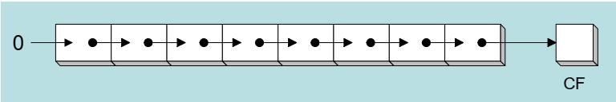
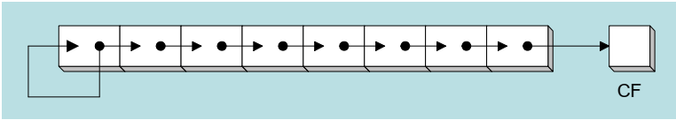
Logical vs Arithmetic shifts
A logical shift fills the newly created bit position with zero
An arithmetic shift fills the newly created bit position with a copy of the number’s sign bit

Slide 6
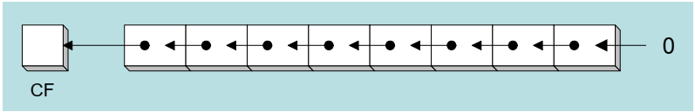
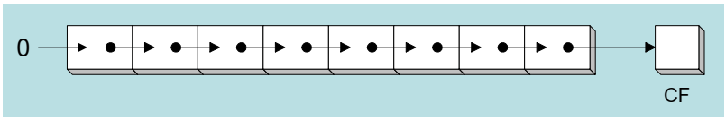
SHL & SHR Instruction
The SHL (shift left) instruction performs a logical left shift on the destination operand, filling the lowest bit with 0
The SHR (shift right) instruction performs a logical right shift on the destination operand, the highest bit position is filled with a zero
Syntax:
  SHL reg\mem , imm8 \ CL
  SHR reg\mem , imm8 \ CL

Slide 7
Effects on Flags
SF, PF, ZF reflect the result
AF is undefined
CF = last bit shifted out
OF = 1 if result changes sign on last shift

Slide 8
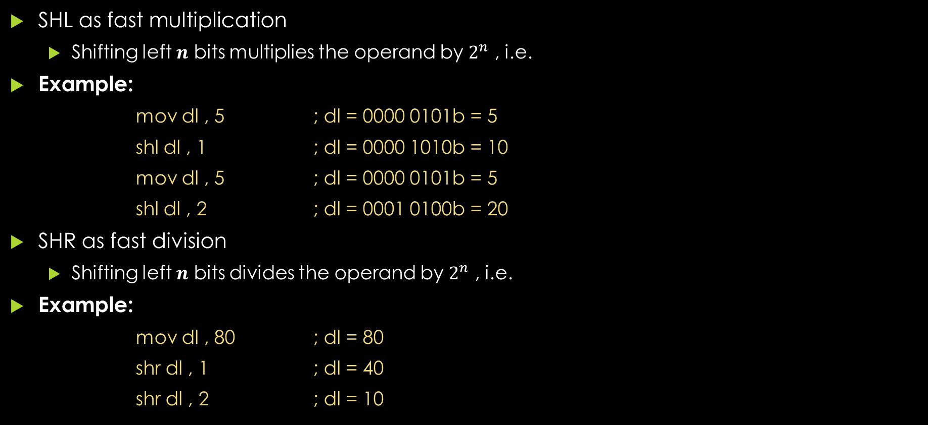
Application
SHL as fast multiplication
  Shifting left $n$ bits multiplies the operand by $2^{n}$ , i.e.
Example:
  mov dl , 5 ; dl = 0000 0101b = 5
  shl dl , 1 ; dl = 0000 1010b = 10
  mov dl , 5 ; dl = 0000 0101b = 5
  shl dl , 2 ; dl = 0001 0100b = 20
SHR as fast division
  Shifting left $n$ bits divides the operand by $2^{n}$ , i.e.
Example:
  mov dl , 80 ; dl = 80
  shr dl , 1 ; dl = 40
  shr dl , 2 ; dl = 10

Slide 9
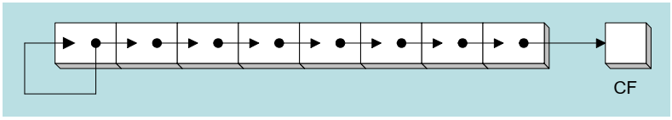
SAL & SAR Instruction
SAL (shift arithmetic left) is identical to SHL.
SAR (shift arithmetic right) performs a right arithmetic shift on the destination operand
  An arithmetic shift preserves the number s sign 's sign
Syntax:
  SAL reg\mem , imm8 \ CL
  SAR reg\mem , imm8 \ CL
Example:
  mov dl , -80
  sar dl ,1 ; DL = -40
  sar dl , 2 ; DL = -10

Slide 10
Application
You can divide a signed operand by a power of 2, using the SAR instruction
Example:
  mov dl , −128 ; DL = 10000000b = -128
  sar dl , 3 ; DL = 11110000b = -16
Suppose AX contains a signed integer and you want to extend its sign into EAX. First shift EAX 16 bits to the left, then shift it arithmetically 16 bits to the right:
Example:
  mov ax , −128 ; EAX = ????FF80h
  shl eax ,16 ; EAX = FF800000h
  sar eax ,16 ; EAX = FFFFFF80h

Slide 11
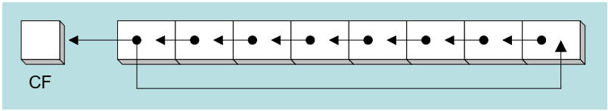
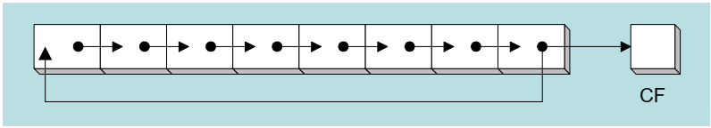
ROL & ROR Instruction
ROL (rotate) shifts each bit to the left
  The highest bit is copied into both the Carry flag and into the lowest bit
  No bits are los shift preserves the number s sign 's sign
ROR (rotate right) shifts each bit to the right
  The lowest bit is copied into both the Carry flag and into the highest bit
  No bits are lost
Syntax:
  ROL reg\mem , imm8 \ CL
  ROR reg\mem , imm8 \ CL

Slide 12
Application
Example:
  mov al , 11110000b
  rol al , 1 ; AL = 1110 0001b
  mov dl , 3Fh
  rol dl , 4 ; DL = F3h
Example:
  mov al , 11110000b
  ror al , 1 ; AL = 0111 1000b
  mov dl , 3Fh
  ror dl , 4 ; DL = F3h

Slide 13
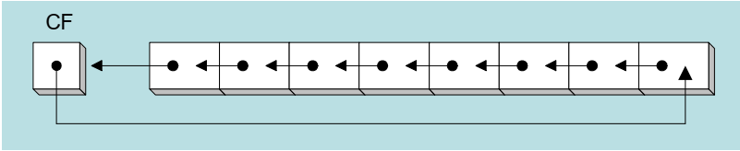
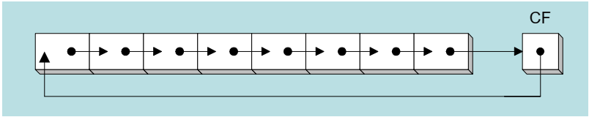
RCL & RCR Instruction
RCL (rotate carry left) shifts each bit to the left
  Copies the Carry flag to the least significant bit
  Copies the most significant bit to the Carry flags sign
RCR (rotate carry right) shifts each bit to the right
  Copies the Carry flag to the most significant bit
  Copies the least significant bit to the Carry flag
Syntax:
  RCL reg\mem , imm8 \ CL
  RCR reg\mem , imm8 \ CL

Slide 14
Application
Example:
  clc ; CF = 0
  mov bl , 88h ; CF = 0, BL = 1000 1000b
  rcl bl , 1 ; CF = 1, BL = 0001 0000b
  rcl bl , 1 ; CF = 0, BL = 0010 0001b
Example:
  stc ; CF = 1
  mov ah , 10h ; CF = 1, AH = 0001 0000
  rcr ah , 1 ; CF = 0, AH = 1000 1000

Slide 15
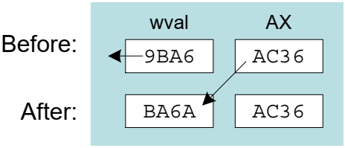
SHLD Instruction
Syntax (shift left double):
  SHLD destination , source , count
Shifts a destination operand a given number of bits to the left
  The bit positions opened up by the shift are filled by the most significant bits of the source operand
  The source operand is not affected
Example:
  .data
  wval WORD 9BA6h
  .code
  mov ax , 0AC36h
  shld wval, ax , 4

Slide 16
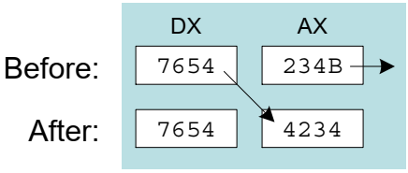
SHRD Instruction
Syntax (shift right double):
  SHRD destination , source , count
Shifts a destination operand a given number of bits to the right
  The bit positions opened up by the shift are filled by the least significant bits of the source operand
  The source operand is not affected
Example:
  .code
  mov ax , 234Bh
  mov dx , 7654h
  shrd ax , dx , 4

Slide 17
Application
SHLD and SHRD can be used to manipulate bit-mapped images, when groups of bits must be shifted left and right to reposition images on the screen.
Another potential application is data encryption, in which the encryption algorithm involves the shifting of bits.
Finally, the two instructions can be used when performing fast multiplication and division with very long integers.

Slide 18
Shift and Rotate Applications
Shifting Multiple Doublewords
Binary Multiplication
Displaying Binary Bits
Isolating a Bit String

Slide 19

Shifting Multiple Doublewords
Programs sometimes need to shift all bits within an array, as one might when moving a bitmapped graphic image from one screen location to another
The following shifts an array of 3 doublewords 1 bit to the right
Example:
  shr array[esi + 8] , 1 ; high dword
  rcr array[esi + 4] , 1 ; middle dword
  rcr array[esi] , 1 ; low dword

Slide 20
Binary Multiplication
We already know that SHL performs unsigned multiplication efficiently when the multiplier is a power of 2
Factor any binary number into powers of 2
  For example, to multiply EAX * 36, factor 36 into 32 + 4 and use the distributive property of multiplication to carry out the operation:
Example:
EAX * 36=EAX * (32 + 4)
= (EAX * 32)+(EAX * 4)
mov eax,123
mov ebx,eax
shl eax 5 ,5
shl ebx,2
add eax,ebx

Slide 21
Displaying Binary Bits
Algorithm:
  Shift MSB into the Carry flag; If CF = 1, append a “1” character to a string; otherwise, append a “0” character
  Repeat in a loop, 32 times
Code:
  mov ecx, 32
  mov esi, offset buffer
  L1:
  shl eax,1
  mov BYTE PTR [esi],'0’
  jnc L2
  mov BYTE PTR [esi],'1'
  L2: inc esi
  loop L1

Slide 22
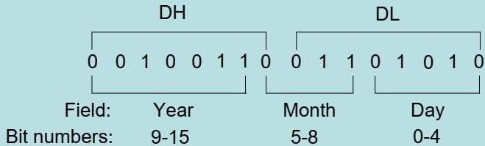
Isolating a Bit String
The MS-DOS file date field packs the year (relative to 1980) month and day into 16 bits:
mov ax , dx ; make a copy of DX
shr ax , 5 ; shift right 5 bits
and al , 00001111b ; clear bits 4-7
mov month , al ; save in month variable
mov al , dh ; make a copy of DX
shr al , 1 ; shift right 1 bit
mov ah , 0 ; clear AH to 0
add ax , 1980 ; year is relative to 1980
mov year , ax ; save n year
mov al , dl ; make a copy of DL
and al , 00011111b ; clear bits 5 ,00011111b ; clear bits 5-7
mov day , al ; save in day variable

Slide 23
Multiplication
&
Division

Slide 24
MUL Instruction
The MUL (unsigned multiply) instruction multiplies an 8-, 16-, or 32-bit operand by either AL, AX, or EAX
The multiplier and multiplicand must always be the same size, and the product is twice their size
Syntax:
  MUL r/m8
  MUL r/m16
  MUL r/m32
Multiplicand | Multiplier | Product
AL | r/mem 8 | AX
AX | r/mem 16 | DX:AX
EAX | r/mem 32 | EDX:EAX

Slide 25
MUL Instruction
In case of 16 bit MUL; the Carry flag is set if DX is not equal to zero, which lets us know that the product will not fit into the lower half of the implied destination operand
  After MUL, CF/OF=0; if upper half of the result is zero; 1 otherwise
In case of 32 bit MUL; the Carry flag is set if EDX is not equal to zero, which lets us know that the product will not fit into the lower half of the implied destination operand
  After MUL, CF/OF=0; if upper half of the result is zero; 1 otherwise

Slide 26
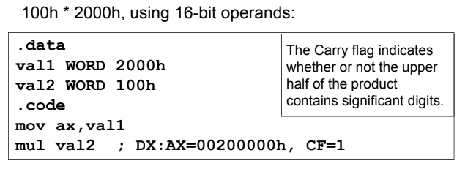
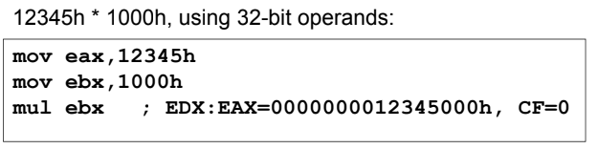
Examples

Slide 27
IMUL Instruction
IMUL (signed integer multiply) multiplies an 8,16, or 32-bit signed operand by either AL AX, or EAX (there are one/two/three operand format)
Preserves the sign of the product by sign-extending it into the upper half of the destination register
Syntax:
One Operand | Two Operand | Three Operand
IMUL r/m8 | IMUL r16 , r/m16/imm8 | IMUL r16 , r/m16, imm8
IMUL r/m16 | IMUL r32 , r/m32/imm8 | IMUL r16 , r/m16, imm16
IMUL r/m32 | IMUL r16 , imm16 | IMUL r32 , r/m32, imm8
 | IMUL r32 , imm32 | IMUL r32 , r/m32, imm32

Slide 28
IMUL Instruction
The one-operand formats store the product in AX, DX:AX, or EDX : EAX (Same like MUL Instruction)
Two-Operand Formats: stores the product in the first operand, which must be a register
  The second operand (the multiplier) can be a register, a memory operand, or an immediate value
  The two-operand formats truncate the product to the length of the destination, if significant digits are lost, the Overflow and Carry flags are set
The three-operand formats in 32-bit mode store the product in the first operand
  The second operand can be a 16-bit register or memory operand, which is multiplied by the third operand, an 8- or 16-bit immediate value

Slide 29

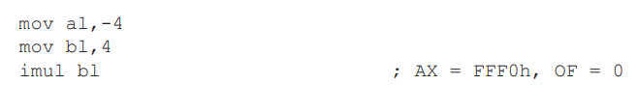
IMUL Instruction
After IMUL, CF/OF = 0, if the upper half of the result is the sign extension of the lower half; CF/OF = 1 otherwise
This means that the bits of the upper half are the same as the sign bit of the lower half

Slide 30
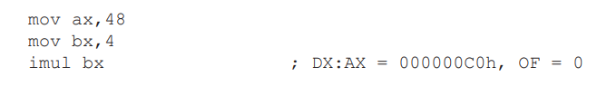
IMUL Instruction
The following instructions multiply 48 by 4, producing +192 in DX:AX. DX is a sign extension of AX, so the Overflow flag is clear

Slide 31
Multiplication & Division Instructions
In 32-bit mode, integer multiplication can be performed as a 32-bit, 16-bit, or 8-bit operation
The process of multiplication and division is different for signed and unsigned numbers, so there are different Instructions for signed and unsigned multiplication and division
The MUL and IMUL instructions perform unsigned and signed integer multiplication, respectively
The DIV instruction performs unsigned integer division, and IDIV performs signed integer division

Slide 32
Signed Vs Unsigned Multiplication
Suppose we want to multiply the eight-bit numbers 10000000 and 11111111
Interpreted as unsigned numbers, they represent 128 and 255; respectively, the product is 32,640
However, taken as signed numbers, they represent-128 and -1, respectively; and the product is 128
Thus signed and unsigned numbers must be treated differently

Slide 33
DIV Instruction
The DIV (unsigned divide) instruction performs 8-bit,16-bit and 32-bit division on unsigned integers
A single operand is supplied (register or memory operand), which is assumed to be the divisor
Syntax:
  DIV r/m8
  DIV r/m16
  DIV r/m32
Dividend | Divisor | Quotient | Remainder
AX | r/mem 8 | AL | AH
DX:AX | r/mem 16 | AX | DX
EDX:EAX | r/mem 32 | EAX | EDX

Slide 34
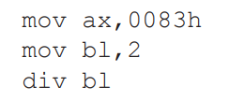
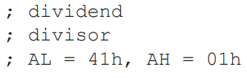
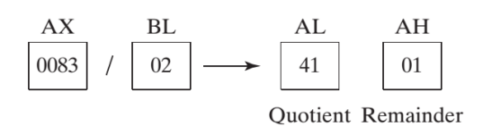
DIV Instruction
Where the single reg/mem operand is divisor
When division is performed, we obtain two results, the quotient and the remainder
Quotient and remainder have the same size as the divisor
Example:

Slide 35
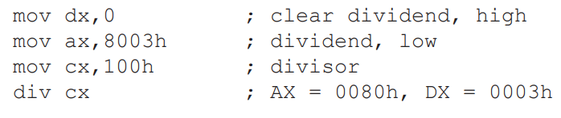
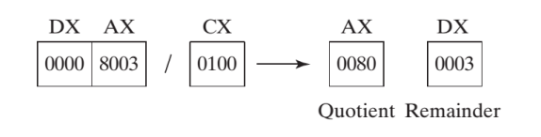
DIV Instruction
In word (16-bit) division, the dividend is in DX:AX even if the actual dividend will fit in AX. In this case DX should be cleared
Example:

Slide 36
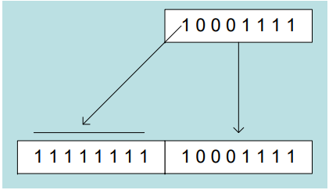
SIGNED Integer Division
Signed integers must be sign-extended before division takes place
Fill high byte/word/doubleword with a copy of the low byte/word/doubleword's sign bit
  For example: the high byte contains a copy of the sign bit from the low byte:

Slide 37
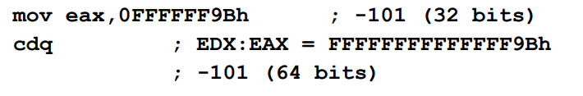
CBW, CWD, CDQ Instructions
The CBW, CWD, and CDQ instructions provide important sign-extension operations:
  The CBW instruction (convert byte to word) extends the sign bit of AL into AH
  The CWD (convert word to doubleword) instruction extends the sign bit of AX into DX
  The CDQ (convert doubleword to quadword) instruction extends the sign bit of EAX into EDX

Slide 38
IDIV Instruction
IDIV (signed divide) performs signed integer division
Uses same operands as DIV instruction
Syntax:
  DIV r/m8
  DIV r/m16
  DIV r/m32
Dividend | Divisor | Quotient | Remainder
AX | r/mem 8 | AL | AH
DX:AX | r/mem 16 | AX | DX
EDX:EAX | r/mem 32 | EAX | EDX

Slide 39
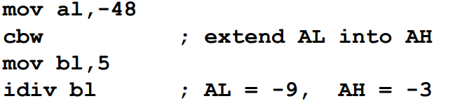
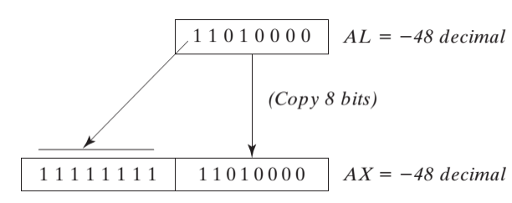
IDIV Instruction
Before executing 8-bit division, the dividend (AX) must be completely sign-extended

Slide 40
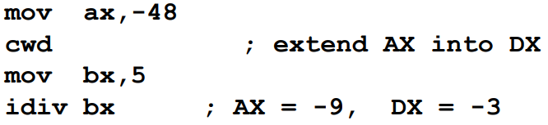
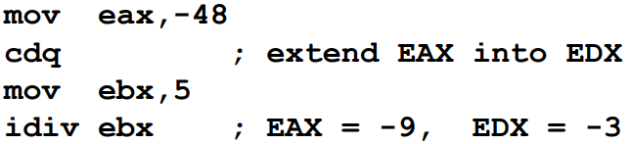
IDIV Instruction
Example: 16-bit division of –48 by 5
Example: 32-bit division of –48 by 5

Slide 41
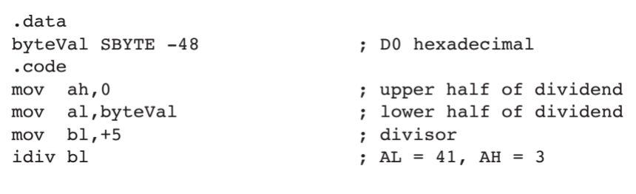
Need of Sign Extension

Slide 42
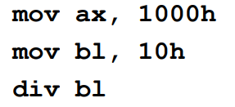
Divide Overflow
Divide overflow happens when the quotient is too large to fit into the destination
It causes a CPU interrupt and halts the program. (divided by zero cause similar results)

Slide 43
Extended addition
&
subtraction

Slide 44
ADC Instruction
The ADC (add with carry) instruction adds both a source operand and the contents of the Carry flag to a destination operand
The instruction formats are the same as for the ADD instruction, and the operands must be the same size
Syntax:
  ADC reg , reg
  ADC mem , reg
  ADC reg , mem
  ADC reg , imm
  ADC mem , imm

Slide 45
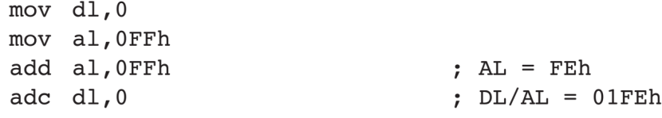
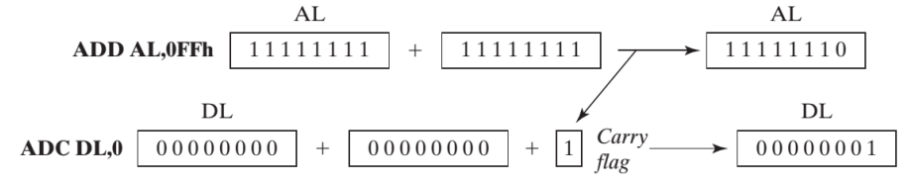
ADC Instruction

Slide 46
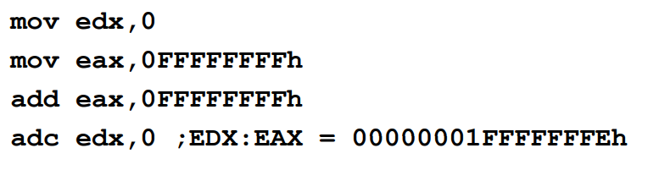
ADC Instruction

Slide 47
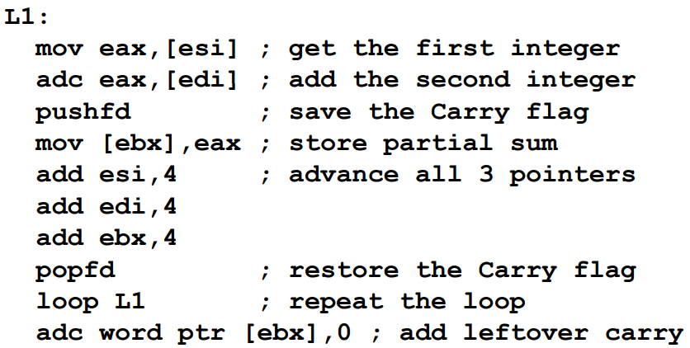
Application
Add two integers of any size
Pass pointers to the addends (ESI EDI) and sum Pass pointers to the addends (ESI , EDI) and sum (EBX), ECX indicates the number of doublewords

Slide 48
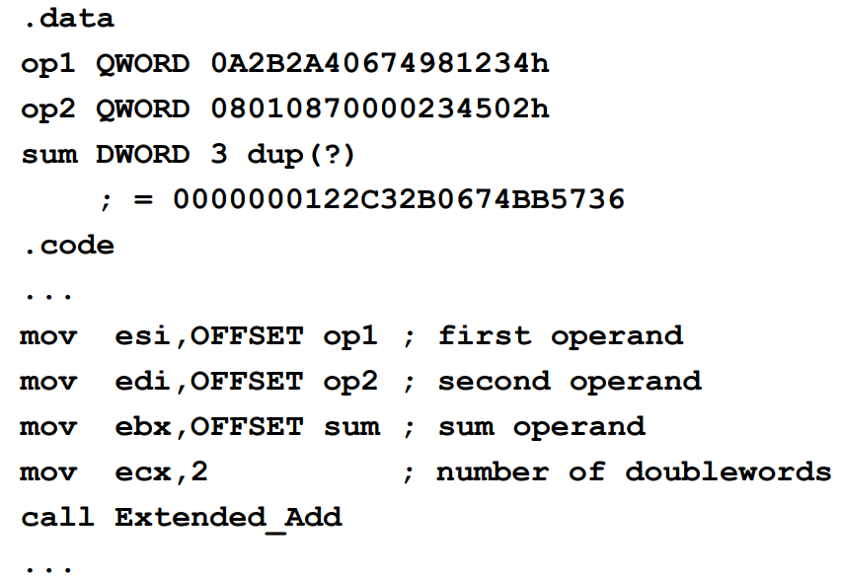
Example

Slide 49
SBB Instruction
The SBB (subtract with borrow) instruction subtracts both a source operand and the value of the Carry flag from a destination operand
The instruction formats are the same as for the SUB instruction, and the operands must be the same size
The possible operands are the same as for the ADC instruction
Syntax:
  SBB reg , reg
  SBB mem , reg
  SBB reg , mem
  SBB reg , imm
  SBB mem , imm

Slide 50

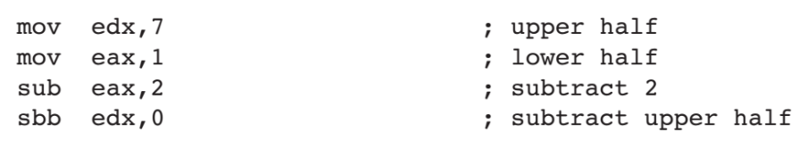

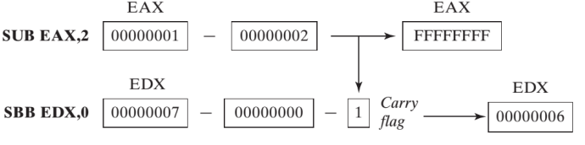
Example

Slide 51
Stack Frames, Parameters
&
local variables

Slide 52
Stack Frame
Also known as an activation record
Area of the stack set aside for a procedure’s return address, passed parameters, saved registers, and local variables
Created by the following steps:
  Calling procedure pushes arguments on the stack and calls the procedure
  The subroutine is called, causing the return address to be pushed on the stack
  The called procedure pushes EBP on the stack, and set EBP to ESP
  If local variables are needed, a constant is subtracted from ESP to make room on the stack
  The registers needed to be saved are pushed

Slide 53
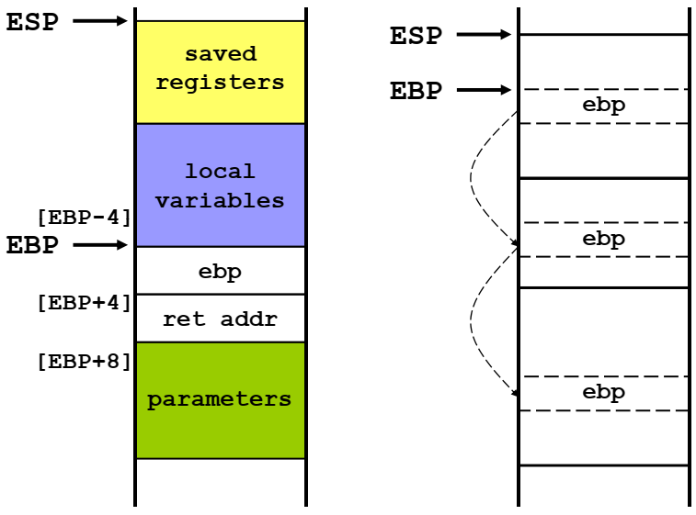
Stack Frame

Slide 54
Explicit Access to Stack Parameters
A procedure can explicitly access stack parameters using constant offsets from EBP
  Example: [EBP + 8]
EBP is often called the base pointer or frame pointer because it holds the base address of the stack frame
EBP does not change value during the procedure
EBP must be restored to its original value when a procedure returns

Slide 55
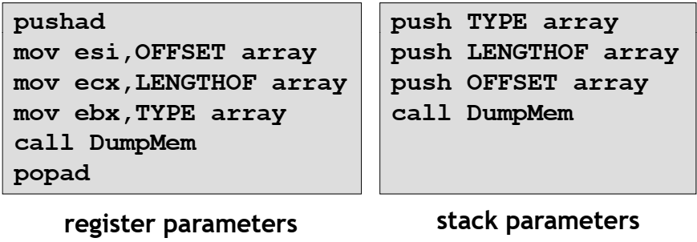
Parameters
Two types: register parameters and stack parameters
Stack parameters are more convenient than register param

Slide 56
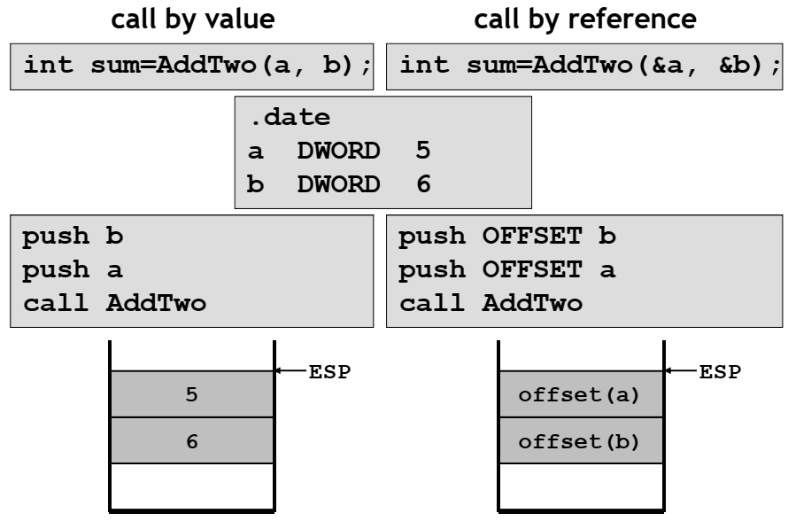
Parameters

Slide 57
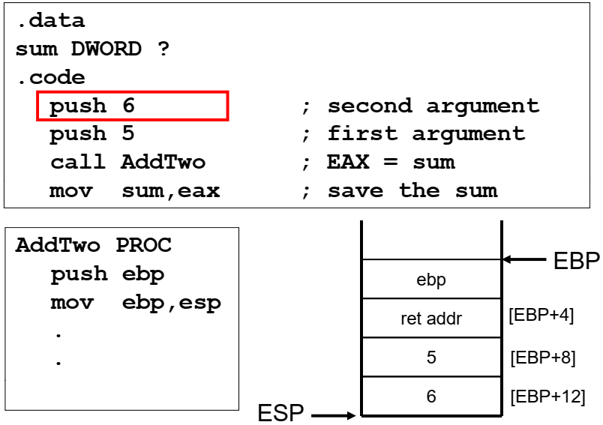
Parameters

Slide 58
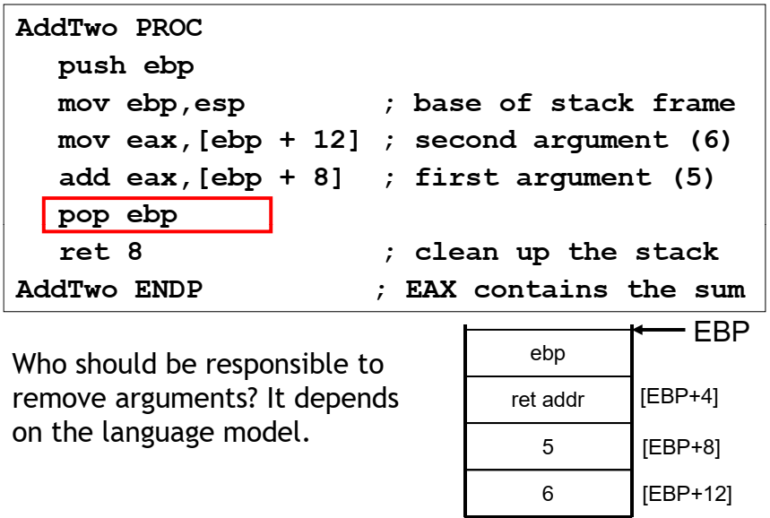
Parameters

Slide 59
Passing Arguments by Reference
The ArrayFill procedure fills an array with 16-bit random integers
The calling program passes the address of the array, along with a count of the number of array elements
.data
count = 100
array WORD count DUP(?)
.code
push OFFSET array
push COUNT
call ArrayFill

Slide 60
Passing Arguments by Reference
ArrayFill can reference an array without knowing the array's name
ArrayFill PROC
push ebp
mov ebp, esp
pushad
mov esi,[ebp+12]
mov ecx, [ebp+8]
…
…

Slide 61
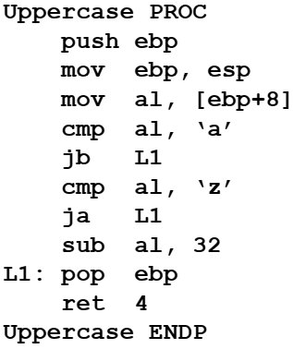

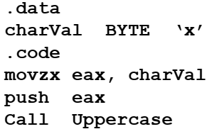
Passing 8-bit & 16-bit argument
When passing stack arguments, it is best to push 32-bit operands to keep ESP aligned on a doubleword boundary

Slide 62
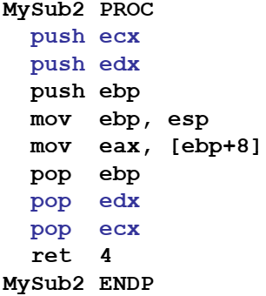
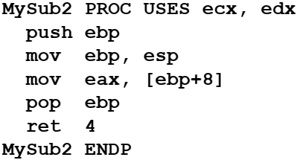
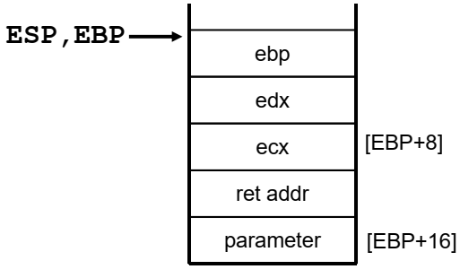
Saving & Restoring register
When using stack parameters, avoid USES

Slide 63
Local Variables
The variables defined in the data segment can be taken as static, global variables
  Visibility
    Static → program duration
    Global → the whole program
A local variable is created, used, and destroyed within a single procedure (block)
Advantages of local variables:
  Restricted access: easy to debug, less error prone
  Efficient memory usage
  Same names can be used in two different procedures
  Essential for recursion

Slide 64
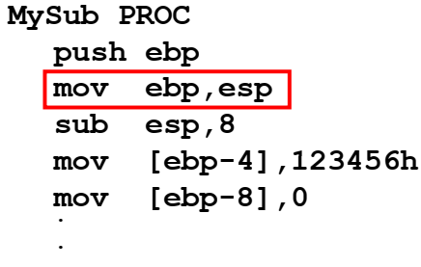
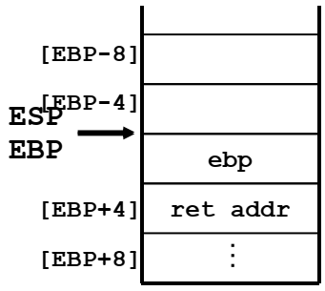
Creating Local Variable
Local variables are created on the runtime stack, usually above EBP
To explicitly create local variables, subtract their total size from ESP

Slide 65
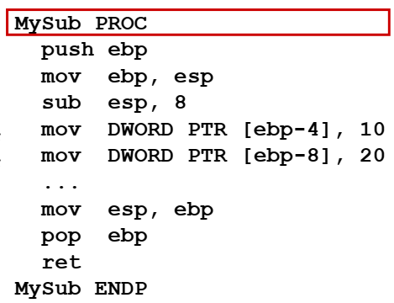


Local Variable
They can’t be initialized at assembly time but can be assigned to default values at runtime

Slide 66
Local Variables
X_local EQU DWORD PTR [ebp-4]
Y_local EQU DWORD PTR [ebp-8]
MySub PROC
push ebp
mov ebp, esp
sub esp, 8
mov X_local, 10
mov Y_local, 20
...
mov esp, ebp
pop ebp
ret
MySub END

Slide 67
LEA Instruction
The LEA instruction returns offsets of both direct and indirect operands at run time
  OFFSET only returns constant offsets (assemble time).
LEA is required when obtaining the offset of a stack parameter or local variable
For example:
CopyString PROC,
count:DWORD
LOCAL temp[20]:BYTE
mov edi, OFFSET count ; invalid operand
mov esi, OFFSET temp ; invalid operand
lea edi, count ; ok
lea esi, temp ; ok

Slide 68


Example

Slide 69

Enter & LEAVE
ENTER instruction creates stack frame for a called procedure
  pushes EBP on the stack push ebp
  set EBP to the base of stack frame mov ebp, esp
  reserves space for local variables sub esp, n
ENTER nbytes, nestinglevel
  nbytes (for local variables) is rounded up to a multiple of 4 to keep ESP on a doubleword boundary
  nestinglevel: 0 for now
LEAVE reverses the action of a previous ENTER instruction

Slide 70
Enter & LEAVE
*NOTE: If the nesting level is 0, the processor pushes the frame pointer from the BP/EBP/RBP register onto the stack, copies the current stack pointer from the SP/ESP/RSP register into the BP/EBP/RBP register, and loads the SP/ESP/RSP register with the current stack-pointer value minus the value in the size operand. For nesting levels of 1 or greater, the processor pushes additional frame pointers on the stack before adjusting the stack pointer. These additional frame pointers provide the called procedure with access points to other nested frames on the stack.

Slide 71


Example

Slide 72


LOCAL directive
The LOCAL directive declares a list of local variables
  immediately follows the PROC directive
  each variable is assigned a type
Syntax:
LOCAL varlist

Slide 73



LOCAL directive
Local variables can be different sizes
How are they created in the stack by LOCAL directive:
  8-bit: assigned to next available byte
  16-bit: assigned to next even (word) boundary
  32-bit: assigned to next doubleword bound

Slide 74

Recursion
The process created when . . .
  A procedure calls itself
  Procedure A calls procedure B, which in turn calls procedure A
Using a graph in which each node is a procedure and each edge is a procedure call, recursion forms a cycle

Slide 75



Recursion
This function calculates the factorial of integer n
A new value of n is saved in each stack frame

Slide 76


Recursion

Slide 77
MODEL directive
.MODEL directive specifies a program's memory model and model options (language-specifier)
Syntax:
.MODEL memorymodel [,modeloptions]
memorymodel can be one of the following:
  tiny, small, medium, compact, large, huge, or flat
modeloptions includes the language specifier:
  procedure naming scheme
  parameter passing conventions
Example:
.MODEL flat, STDCALL

Slide 78
MEMORY models
A program's memory model determines the number and sizes of code and data segments
Real-address mode supports tiny, small, medium, compact, large, and huge models
  Small model: code < 64 KB, data (including stack) < 64 KB, all offsets are 16 bits
Protected mode supports only the flat model
  Flat model: single segment for code and data, up to 4 GB, all offsets are 32 bits

Slide 79
Language specifiers
STDCALL (used when calling Windows functions)
  procedure arguments pushed on stack in reverse order (right to left)
  called procedure cleans up the stack
  _name@nn (for example: _AddTwo@8)
C
  procedure arguments pushed on stack in reverse order (right to left)
  calling program cleans up the stack (variable number of parameters such as printf)
  _name (for example, _AddTwo)
PASCAL
  arguments pushed in forward order (left to right)
  called procedure cleans up the stack
BASIC, FORTRAN, SYSCAL

Slide 80
INVOKE directive
The INVOKE directive is a powerful replacement for Intel’s CALL instruction that lets you pass multiple arguments
Syntax:
INVOKE procedureName [, argumentList]
ArgumentList is an optional comma-delimited list of procedure arguments
Arguments can be:
  immediate values and integer expressions
  variable names
  address and ADDR expressions
  register names

Slide 81

INVOKE directive

Slide 82


INVOKE directive

Slide 83
ADDR operator
Returns a near or far pointer to a variable, depending on which memory model your program uses:
  Small model: returns 16-bit offset
  Large model: returns 32-bit segment/offset
  Flat model: returns 32-bit offset
Simple example:
.data
myWord WORD ?
.code
INVOKE mySub ,ADDR myWord

Slide 84


ADDR operator

Slide 85
PROC directive
The PROC directive declares a procedure with an optional list of named parameters
Syntax:
label PROC [attributes] [USES] paramList
paramList is a list of parameters separated by commas, each parameter has the following Syntax:
paramName:type
  type must either be one of the standard ASM types (BYTE, SBYTE, WORD, etc.), or it can be a pointer to one of these types
Example:
foo PROC USES eax, param1:DWORD

Slide 86


PROC directive
The AddTwo procedure receives two integers and returns their sum in EAX
C++ programs typically return 32-bit integers from functions in EAX

Slide 87


PROC directive

Slide 88

PROTO directive
Creates a procedure prototype
Syntax:
label PROTO paramList
Every procedure called by the INVOKE directive must have a prototype
A complete procedure definition can also serve as its own prototype
Standard configuration: PROTO appears at top of the program listing, INVOKE appears in the code segment, and the procedure implementation occurs later in the program:

Slide 89


PROTO directive
Prototype for the ArraySum procedure, showing its parameter list:

Slide 90
PROTO directive
Task 1: Write a code that uses below described subroutine with different data types:
“A subroutine (entitled as: “ArraySum”) in assembly language using INVOKE directive, that takes input arguments; offset of array, length of array and type of array and display the sum on screen. Arguments should be passed using stack and it should be focused that values of GPRs should not change before and after calling of subroutine. (Sum should be calculated in 32bits, despite of the type of array).”

Slide 91
PROTO directive

Slide 92
Multimodule programs
A multimodule program is a program whose source code has been divided up into separate ASM files
Each ASM file (module) is assembled into a separate OBJ file
All OBJ files belonging to the same program are linked using the link utility into a single EXE file
  This process is called static linking
Advantages:
  Large programs are easier to write, maintain, and debug when divided into separate source code modules
  When changing a line of code, only its enclosing module needs to be assembled again Linking assembled modules requires, linking assembled modules requires little time
  A module can be a container for logically related code and data
    encapsulation: procedures and variables are automatically hidden in a module unless you declare them public

Slide 93
Multimodule programs
Here are some basic steps to follow when creating a multimodule program:
Create the main module
Create a separate source code module for each procedure or set of related procedures
Create an include file that contains procedure prototypes for external procedures (ones that are called between modules)
Use the INCLUDE directive to make your procedure prototypes available to each module

Slide 94
Multimodule programs
By default, MASM makes all procedures public, permitting them to be called from any other module in the same program
You can override this behavior using the PRIVATE qualifier:
mySub PROC PRIVATE
Another way to hide procedures inside a source module is to place the OPTION PROC:PRIVATE directive at the top of the file
  Then, you use the PUBLIC directive to identify any procedures you want to export:
  OPTION PROC:PRIVATE
  PUBLIC mySub
  Alternatively, you can designate individual procedures as public:
  mySub PROC PUBLIC
  …
  mySub ENDP

Slide 95
Multimodule programs
Variables and symbols are, by default, private to their enclosing modules
You can use the PUBLIC directive to export specific names, as in the following example:
PUBLIC count, SYM1
SYM1 = 10
.data
count DWORD 0

Slide 96
Multimodule programs
Two types of Multimode programming:
EXETERN directive
INVOKE & PROTO directive

Slide 97


Slide 98


